Slide 1

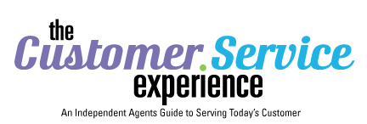

Notes:
This seminar is best suited for a six-hour presentation. If looking to present in a three-hours, it is suggested to cut out the videos, worksheets and some of the foundational slides.

Slide 2
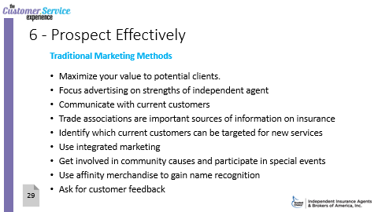
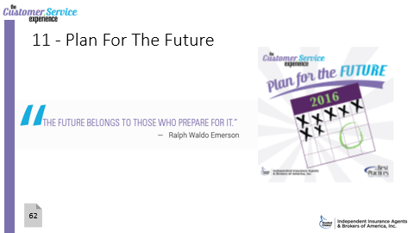
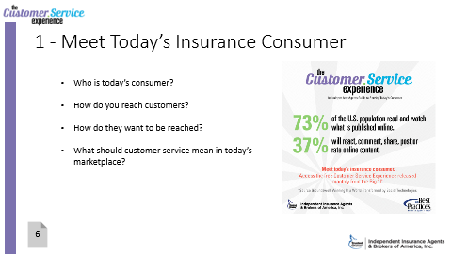
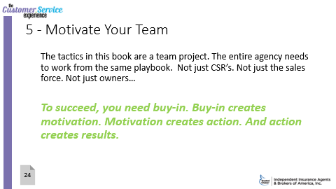
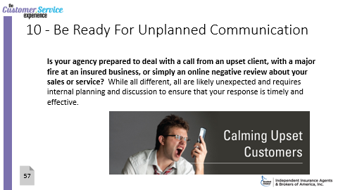
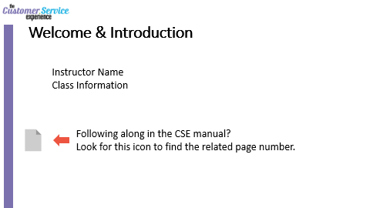
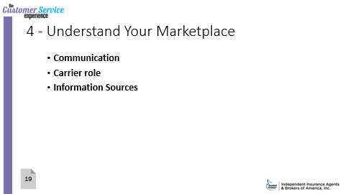
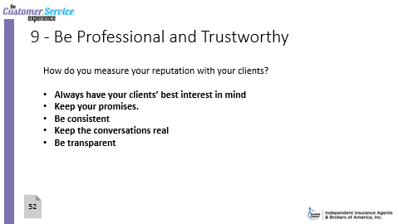
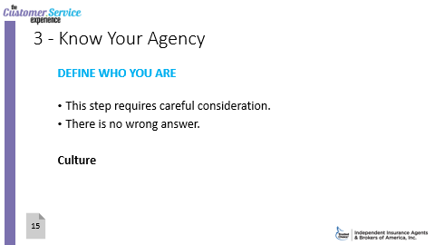
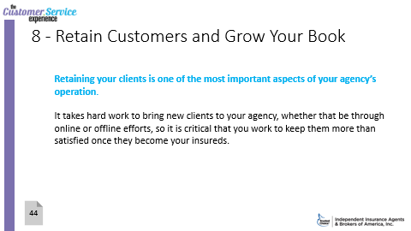
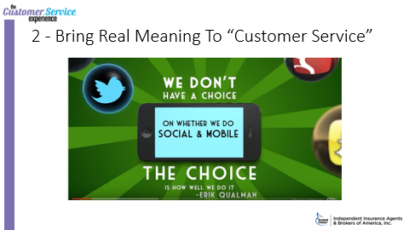
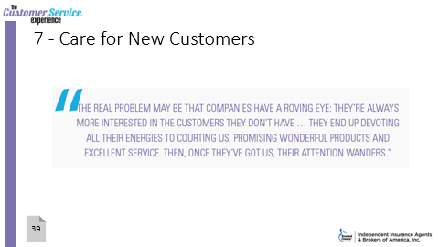
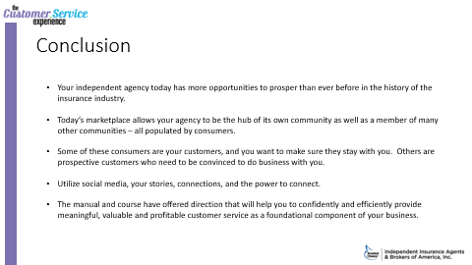

Slide 3
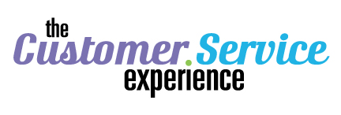
Welcome & Introduction
Instructor Name
Class Information
Following along in the CSE manual?
Look for this icon to find the related page number.
Notes:
Page 4 in CSE
Setting the stage:
Welcome & Icebreaker
Time may vary depending on size of class.
Option: Traditional “name and where are you from?”
Option: Ask each a series of one word response questions: One word to describe your communication with customers.. Effectiveness of communication… your most significant challenge… team relationships.. Are you sunrise, daylight, twilight or night personality.. Describe your boss in one word.. Your work style in one word.
Option: Have a puzzle for each table to put together, or mix up to go to other tables. Have a small prize for the table that finishes first.
Customer Service Experience initially rolled out by IIABA as a monthly resource. Positive feedback and on trend with what was needed in today’s agency as a guide to serving today’s consumer in a complex marketplace.
Independent Agencies have the opportunity to prosper:
Complex Marketplace
Understand customers
Insurance is hub of community
Ask: Who is today’s consumer? What does “customer service” mean in today’s marketplace?
The CSE guide and today’s class can help provide direction, thought and exercise to make an immediate impact.

Slide 4
1 - Meet Today’s Insurance Consumer
Who is today’s consumer?
How do you reach customers?
How do they want to be reached?
What should customer service mean in today’s marketplace?
6
Notes:
Page 6 in CSE
Lots of questions, right?
Who is today’s consumer?
How do you reach customers?
How do they want to be reached?
What should customer service mean in today’s marketplace?
Most personal lines insurance consumers begin their search online. Only 20% depend on agent alone to do their research. (Source: 2012 McKinsey Auto Insurance Consumer Insights Research)
OPTIONAL WORKSHEET – “What To Think About and What To Do” (Page 69 in CSE)
If a three-hour class, this can be referenced as something to use back in the office.
If a six-hour class, attendees can take time to go through the questions and ask to share results and feedback.

Slide 5
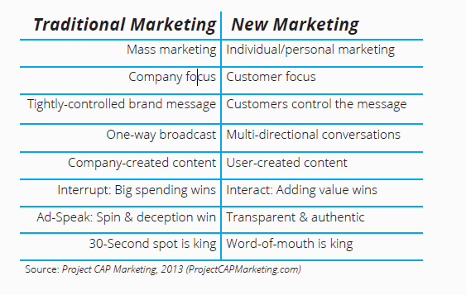
1 - Meet Today’s Insurance Consumer
7
Notes:
Page 7 in CSE
YOUR CUSTOMER CONNECTIONS
Traditional Marketing.
Much of it is still effective and works. Recognizable. Been around forever. Product or services marketing to the point to consumers.
TV ads and spots = like the Superbowl or ongoing campaigns
Some are catchy and end of with their own life – Nike’s “Just Do It” or McDonald’s “You Deserve a Break Today” or even parts of an ad catch on “Can You Hear Me Now?” but it takes getting that message out to the masses
Print marketing = telephone book, that’s gone the way of the dinosaurs; postcards, leaving flyers at your local businesses
Direct mail
Telemarketing = cold calls, buying lists
Radio ads
Referrals
Can be expensive. It’s only way one (other than telemarketing.) Holds attention for a short period of time.
New Marketing
Evolving. Often multi-directional. You want people to be interested in “you” before buying.
Interact – much of this is social media and ties in multi-directional conversations.
Social Networks (Facebook, Twitter, Snapchat, LinkedIn, Instagram, Periscope, Pintrest)
Think of more content marketing – you are giving information, the product is a after-thought
Websites
Blogging – Shows personality, opinion. Gravitate to those who we agree with your point of view
“Going Viral” – can happen on accident and be positive or negative – acts of kindness, acts of stupidity, poor customer service
The best blend is probably a mix of both, but if your agency is not open to incorporating new marketing, you are going to miss out on a large demographic who routinely go online for information and reviews to make purchasing decisions

Slide 6
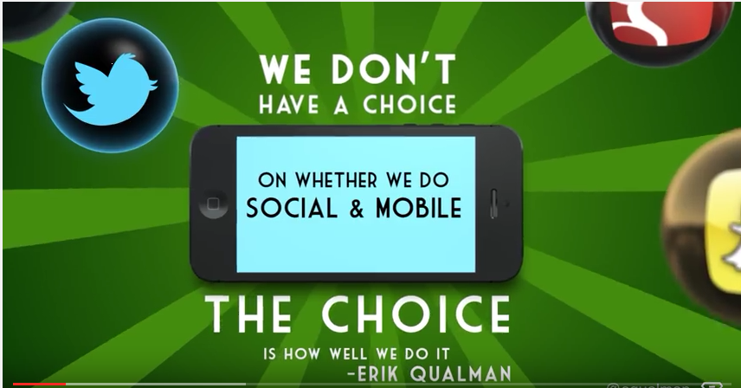
2 - Bring Real Meaning To “Customer Service”
Notes:
OPTIONAL VIDEO: 2:28 video showcasing the power of social and mobile. Created by best selling author and keynote speaker Erik Qualman (@equalman). Socialnomics 2017 by Erik Qualman. More information at http://www.equalman.com. Socialnomics 2017. This is 7th version of this Social Media Revolution Series by Erik Qualman based on his #1 Bestseller Socialnomics. Published on Oct 25, 2016. #Socialnomics
ACTIVE LINK: The quote is linked to the optional video.
------------
RELATED RESOURCE: Customer Service Experience Week is October 3-7 (Source: http://www.csweek.com/customer_service_week_background.php)
Morale. Motivation. Teamwork. A chance to reward frontline representatives and thank departments for their support. Also remind customers how important service is to an organization.

Slide 7
2 - Bring Real Meaning To “Customer Service”
Differentiating independent agencies from competitors
Meeting and exceeding customer expectations
Responding to feedback
Providing the trust and expertise needed
Deliver over and above client expectations.
10
Notes:
Page 10 in CSE
AGENCY EXAMPLES:
Agency in Columbia, SC offers free “video” service for high-value homeowners to catalog their contents
A coastal agency provides clients with a hurricane checklist that includes items to stock, emergency phone numbers, and evacuation routes
Agency newsletters that provide important insurance tips (vacation travel, receiving gifts that may need to be insured, etc.) and give updates on coverages.
Add your own
OPTIONAL VIDEO: 1:54 second clip of bad customer service examples. https://www.youtube.com/watch?v=9oywp2qRRyc
The takeaway is no one wants to be on the other side of that kind of customer service. See what the customer would see about you.
ACTIVE LINK: The quote is linked to the optional video.

Slide 8
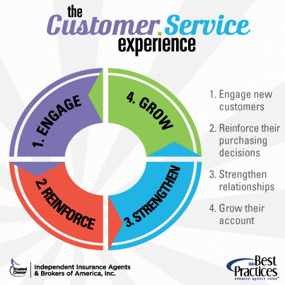
2 - Bring Real Meaning To “Customer Service”
12
Notes:
A high level look at the client cycle
ENGAGE: Engage new customers.
REINFORCE: Reinforce their purchasing decisions.
STRENGTHEN: Strengthen relationships.
GROW: Grow their account.
-----
Graphic also on CSE Page 12.
Where did your customers go? What do you think? (Source: According to Customer Experience Report by Right Now)
3% Move Away
5% Develop Other Business Relationships
9% Leave for Competitive Reasons (Better Price, Etc.)
15% Are Dissatisfied With Your Service
68% Leave because of an attitude of indifference toward them by an owner, manager or other employee!

Slide 9
2 - Bring Real Meaning To “Customer Service”
STEP ONE:
Consider What’s Required Throughout A Customer Life Cycle
New customers = more handholding
Your existing customers need reinforcement they made the right decision
Refresh relationships
Look for opportunities to upsell existing accounts.
11
Notes:
CSE Page 11
New customers = individual messages that are relevant to their situation, their personal and specific needs can create a long lasting relationship. With insurance the customer probably doesn’t think about them until there is a renewal, bill or a claim.
Reduce churn rate. Learn your customers demographic. There is tons of data out in the world. Customer communications is key, but personalized. Relationships can turn into revenue.
Top five essentials for delivering best in class service (Source: Pitney Bowes)
Customer Data 2) Location 3) Insight 4) Strategy 5) Communication
Customer Data = collecting data on customer behavior, interests, buying patterns
Location = know where your customer comes from and target marketing
Insight = Identify when customers return to your business (loyalty programs, email discounts?)
Strategy = You are defining your journey from the customers point of view
Communications = Email, social media, etc. Some of the items mentioned during traditional and new marketing section

Slide 10
2 - Bring Real Meaning To “Customer Service”
STEP TWO:
Convey the Benefits You Provide As An Independent Agent
Understands the worries other business owners face
Flexibility
Personal interest in seeing every client succeed
Local, accessible
Invested in the community
Focused on long-term client relationships, not short-term sales
Ability to create customized coverage—not limited by corporate requirements established by headquarter offices elsewhere
11
Notes:
Page 11 in CSE

Slide 11
2 - Bring Real Meaning To “Customer Service”
STEP THREE:
Have A Consistent Strategy
Personal Touches Count
Be There For Your Clients
Give Them What They Want
Your Agency In The Community
12
Notes:
Page 12 in CSE

Slide 12
2 - Bring Real Meaning To “Customer Service”
STEP FOUR:
Design Your Service Evaluation Process
Get Feedback
Analysis and Response
13
Notes:
Page 13 in CSE
Feedback is only good when processed. Determine general trends and specific goals. Areas for analysis: claims filing, policy updates, information requests. Determine experience at each step in the cycle. Establish rating. And remember, you can’t fix everything at once.
OPTIONAL WORKSHEET – “Bring Real Meaning To Customer Service” (Page 70 in CSE)
If a three-hour class, this can be referenced as something to use back in the office.
If a six-hour class, attendees can take time to go through the questions and ask to share results and feedback.

Slide 13
3 - Know Your Agency
DEFINE WHO YOU ARE
This step requires careful consideration.
There is no wrong answer.
Culture
15
Notes:
Page 15 in CSE
Who you are takes thought: It’s not about what you are — an independent agency operating in X town, with X years experience and X dollars in revenue. This is about the who of your story — what you stand for and how you serve the customer differently than any other agency.
If you can, engage a marketing partner or outside consultant to moderate. It provides an objective perspective to challenge you and ensure that you consider how your definitions translate to the customer.
Culture
How should we approach business? How should we approach business?
What type of day-to-day environment do we want to create? For instance, are we buttoned-up and business-serious, or do we have a more laid-back, personal approach?
Other Thoughts:
If someone who had never been before to your workplace, what one thing would immediately strike them?
How do you characterize how people interact at your organization?
What assumptions underlying your work are simply not questioned?
RELATED RESOURCE: 5 Company Cultures Worth Emulating - Google – Wegmans – DreamWorks Animation – Salesforce.com – Apple (Source: Staples.Com)
http://www.staples.com/sbd/cre/tech-services/explore-tips-and-advice/tech-articles/google-this-5-company-culture-examples-worth-emulating.html

Slide 14
3 - Know Your Agency
Core values
Vision and mission
Goals
16
Notes:
Page 16 in CSE
Core values What’s important to your agency? What do you believe in? Pick a few that resonate with you to discuss.
Giving back to the community
Getting to know customers on a personal level
Work-life balance
Continuing education
Hard-nosed negotiations
No-nonsense, fact-based proposals
Profitability
Market prestige
Superior Customer Service
Creative Online Presence
Vision and mission
Your vision statement should declare what you want to accomplish for your customers and your community. It should be far-reaching and not limited by product descriptors or narrow parameters.
Your mission statement spells out what you need to do to deliver on the vision.
Goals

Slide 15
3 - Know Your Agency
Notes:
OPTIONAL WORKSHEET – “What To Think About and Do” (Page 71-72 in CSE)
If a three-hour class, this can be referenced as something to use back in the office.
If a six-hour class, attendees can take time to go through the questions and ask to share results and feedback.

Slide 16
4 - Understand Your Marketplace
Communication
Carrier role
Information Sources
19
Notes:
Page 19 in CSE
Communication
The internet has shifted control to the consumer. Real time information. Access to information.
Carrier Role
Just a decade ago, agents placed 80 percent of personal auto policies and nearly 100 percent of homeowner and small business policies. Heavy carrier investment has allowed more direct contact between consumers and carriers. Ask consumers who their policy is with and there is an increased chance they name the carrier.
Key Thought: The more successful you are in growing your agency, the more competitors notice - and react to - what you are doing. A very successful sales approach could be no better than average in a short few months after launching. Even loyal customers can be quick to change when offered something newer and more innovative.

Slide 17
4 - Understand Your Marketplace
10 Things To Know About Your Customers
10. Who They Are
9. Their Jobs and Lifestyles
8. Their Buying Motivations
7. Their Expiration Dates
6. Their Insurance Buying Habits
5. Their Financials
21
Notes:
Page 21 in CSE
Let’s Count Them Down!
10. Who They Are - Find out your customers' gender, age, marital status and occupation. For commercial accounts, find out what size and kind of business they are. For example, are they a small privately held company or a big multinational? How many locations? Expansion plans? New product lines?
9. Their Jobs and Lifestyles - Find out their occupations, interests and hobbies. For commercial accounts, , it helps to have an understanding of what their business is trying to achieve long and short term
8. Their Buying Motivations - If you know their reason for buying insurance, it's easier to match their needs to the coverages your agency can offer. New house? New job? Baby? All can be reasons to seek out an agent’s advice!
7. Their Expiration Dates - If you approach a customer just at the time they want to buy, you will massively increase your chances of success. Collect xdates from everyone you meet and ask if you can contact them to provide more information about your services
6. Their Insurance Buying Habits - If your research shows that your target market prefers online information, be sure to make your online offerings are robust, or if they prefer a face-to-face meeting, ensure that you have office hours that can accommodate busy schedules.
5. Their Financials - Your customer’s financial situations can help you determine the best coverage for their situation and allow you to create a plan that protects their assets and is mindful of their pocketbooks.

Slide 18
4 - Understand Your Marketplace
4. Their Values and Beliefs
3. Their Expectations
2. Their View Of Your Agency
1. Their View of Your Competitors
21
Notes:
Page 21 in CSE
Let’s Count Them Down!
4. Their Values and Beliefs - If you know what is valuable to your customers and what makes them tick, you can tailor your sales and service approach to meet their expectations.
3. Their Expectations - Do they expect expert advice, want an online service center, a promptly returned phone call, help with a claim or just doing business with someone they trust. Determine what they want from your agency and make sure that you deliver!
2. Their View Of Your Agency - If your customers enjoy dealing with you and your agency, they will want to continue to do business with you. Do quick surveys after customer interactions, find out where you succeeded and where you might need improvement. Remember, you can only help with any issues that customers have if you know what they are.
1. Their View of Your Competitors - Did they leave a competitor to come to your agency. Have they gotten a few quotes, but didn’t feel the love over the 800 line? Know you stand a much better chance of successfully gaining new customers if you know what they didn’t like about your rivals!
OPTIONAL WORKSHEET – “Things To Consider” (Page 72 in CSE)
If a three-hour class, this can be referenced as something to use back in the office.
If a six-hour class, attendees can take time to go through the questions and ask to share results and feedback.

Slide 19
4 - Understand Your Marketplace

Slide 20
5 - Motivate Your Team
The tactics in this book are a team project. The entire agency needs to work from the same playbook. Not just CSR’s. Not just the sales force. Not just owners…
To succeed, you need buy-in. Buy-in creates motivation. Motivation creates action. And action creates results.
24
Notes:
Page 24 in CSE
So, to succeed, you need buy-in. Buy-in creates motivation. Motivation creates action. And action creates results

Slide 21
5 - Motivate Your Team
1. Establish agency goals with input
2. Share annual or long-range plans, and show how they support individual goals
3. Recognize that money is not the supreme motivator
4. Review plan progress regularly (at least quarterly), so everyone knows how the agency is performing versus plan.
5. Live the plan and stay true to its original focus.
6. Reward ongoing performance.
7. Provide a feedback mechanism.
24
Notes:
Page 24 in CSE

Slide 22
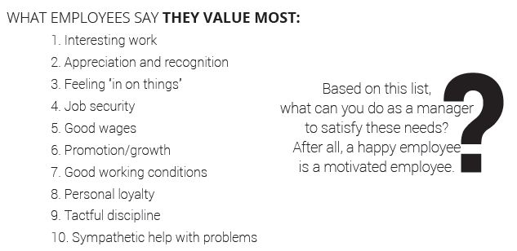
5 - Motivate Your Team
24
Notes:
Page 24 in CSE
What do the attendees value the most? Do they agree with the list?

Slide 23


5 - Motivate Your Team
25
Notes:
Page 25 in CSE
ACTIVE LINK: The image is linked to an audio file.

Slide 24
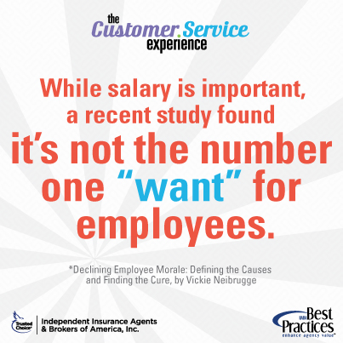
5 - Motivate Your Team
25
Notes:
Page 25 in CSE.
OPTIONAL WORKSHEET – “Motivate Your Team” Checklist and Inventory (Page 73 in CSE)
If a three-hour class, this can be referenced as something to use back in the office.
If a six-hour class, attendees can take time to go through the questions and ask to share results and feedback.

Slide 25

5 - Motivate Your Team
Sample Feedback Script
Thanks for coming to talk with me. I’d like to talk about employee morale. I want to make this job as fulfilling and satisfying for you as I can. Before I can do that, though, I need to know how you feel your job could be made more fulfilling or what other steps we can take to make you feel satisfied in your job.
At this point, if the employee has definite comments or feedback, let the employee talk. Maintain eye contact, take good notes and occasionally nod or smile to let the employee know that you’re listening.
26
Notes:
Page 26 in CSE.
CLASS INVOLVEMENT/OPTIONAL EXERCISE: Take the pulse of the class. See if someone (volunteer) would be interested in doing a dramatic reading of the script and discussion between employee and supervisor. You can read the script and notes on page 26 in the student guide.

Slide 26
5 - Motivate Your Team
the good and bad habits of supervisors and coworkers
the employee’s future at the company and how he or she feels about it
the employee’s workload and the distribution of work in general
the employee’s working conditions and how he or she feels they could be improved
the employee’s feelings about the importance of the work he or she does
how employees get along with each other
the condition of the equipment with which the employee must work
26
Notes:
Page 26 in CSE.
SAMPLES
the good and bad habits of supervisors and coworkers
the employee’s future at the company and how he or she feels about it
the employee’s workload and the distribution of work in general
the employee’s working conditions and how he or she feels they could be improved
the employee’s feelings about the importance of the work he or she does
how employees get along with each other
the condition of the equipment with which the employee must work

Slide 27
5 - Motivate Your Team
the pay and benefits the employee receives and how they compare with other companies
the consistency and fairness in the way employees are treated and disciplined
whether the employee feels that supervisors and coworkers tell the employee what the employee needs to know
the potential for growth/advancement
the employee’s experiences with and feelings about coaching and feedback
the usefulness and appropriateness of instructions and training received
the effectiveness of communication among coworkers and between workers and supervisors
the attitude of the managers/owners toward the employees
26
Notes:
Page 26 in CSE.
SAMPLES
the pay and benefits the employee receives and how they compare with other companies
the consistency and fairness in the way employees are treated and disciplined
whether the employee feels that supervisors and coworkers tell the employee what the employee needs to know
the potential for growth/advancement
the employee’s experiences with and feelings about coaching and feedback
the usefulness and appropriateness of instructions and training received
the effectiveness of communication among coworkers and between workers and supervisors
the attitude of the managers/owners toward the employees

Slide 28
6 - Prospect Effectively
Traditional Marketing Methods
Maximize your value to potential clients.
Focus advertising on strengths of independent agent
Communicate with current customers
Trade associations are important sources of information on insurance
Identify which current customers can be targeted for new services
Use integrated marketing
Get involved in community causes and participate in special events
Use affinity merchandise to gain name recognition
Ask for customer feedback
29
Notes:
Page 29 in CSE
In spite of the social media revolution of the 21st century, some traditional methods of marketing outreach are still crucial.
KEY AREAS FROM THIS PAGE:
The strength of an independent agent:
Finds best policy for price
Available locally
Builds personal relationship
Finds tailored coverage
Identify which current customers can be targeted for new services:
Stimulate cross-buying (auto, home and umbrella). Small commercial buyers indicate an interest in packages designed for their business: key person life, investment services, personal property/casualty, credit products and personal life. Some potential clients are willing to switch providers to get these services.
Independent agents are pillars of their community – fire stations, adopting sports teams, donating, supporting career fairs – it all adds up!

Slide 29
6 - Prospect Effectively
Capitalize on Internet Marketing
No marketing plan is complete without a robust Web site.
Understanding SEO
Meeting TODAY’s customer expectations for what should be on a web
30
Notes:
Page 30 in CSE
Websites must be professionally designed.
Understand the way SEO works – add content regularly – Top 10 Things To Know (Source: IIABA’s Agents Council for Technology)
Definition: Search engine optimization (SEO) is a methodology of strategies, techniques and tactics used to increase the amount of visitors to a website by obtaining a high-ranking placement in the search results page of a search engine (SERP) -- including Google, Bing, Yahoo and other search engines.
1. The Click Is the Thing.
2. Links are Key Too.
3. Relevant Content Matters.
4. Fresh Content is Vital.
5. You Can’t Cheat on Meta tags.
Definition: Meta tags are snippets of text that describe a page's content; the meta tags don't appear on the page itself, but only in the page's code. We all know tags from blog culture, and meta tags are more or less the same thing, little content descriptors that help tell search engines what a web page is about.
6. Pictures and Graphics Matter.
7. Be Patient.
8. It’s Not ‘Once and Done.’
9. SEO May Not be Enough.
10. It’s Worth Handling Professionally.

Slide 30
6 - Prospect Effectively
Social Media
• Give employees who are already good at social media responsibility for it.
• Monitor social media to learn what’s being said about your agency.
• Monitor social media, because some of your customers expect to contact you that way.
• Attract new customers through social media, visit the ACT web and reference “Content Marketing” on page 34 in the manual.
• If you’re developing a mobile app ask for customer feedback.
31
Notes:
Page 31 in CSE
Tips from Agents Council for Technology (ACT):
• Give employees who are already good at social media responsibility for it. For reports to help you guide employees’ social media behavior, visit the ACT web and search “Creating a Social Web Policy Guide”
• Monitor social media to learn what’s being said about your agency.
• Monitor social media, because some of your customers expect to contact you that way.
• Attract new customers through social media, visit the ACT web and reference “Content Marketing” later in this unit.
• If you’re developing a mobile app ask for customer feedback. Ask customers, “What functions would you like to see on it?”

Slide 31
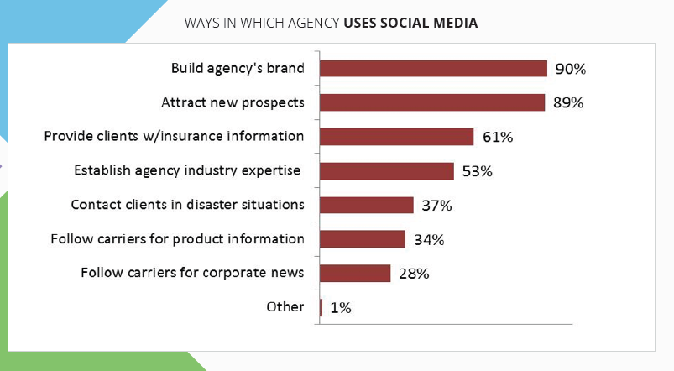
6 - Prospect Effectively
36
Notes:
Page 36 in CSE

Slide 32
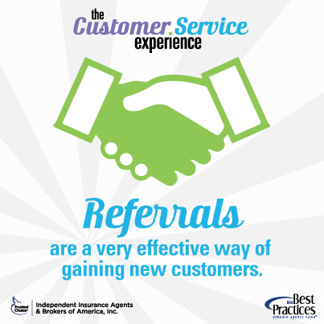
6 - Prospect Effectively
Referrals
Referrals are a very effective way of gaining new customers. But many people have trouble asking for one.
Get over your fear: Most people like to help people
(if no negative cost to them) and the worst that can happen is a “NO”
Methods
Make it standard operation
Consider adding in tagline
LinkedIn
Facebook
Notes:
Page 32 in CSE
PENDING ITEM: Would like to insert an insurance story or TC prospect fact here.

Slide 33
6 - Prospect Effectively
Listen and Offer What The Prospective Customer Needs
Don’t get so wrapped up in what you can offer that you forget to find out what the prospective customer needs.
Bear in mind the old adage: “When my mouth is moving, I’m not learning anything.”
If the prospect asks you about your business or background, answer, but be brief. Then take the focus off yourself and turn it back on the prospect.
Learn what they need: that way you'll have a much easier time presenting them with solutions that meet their needs. When the product matches the client’s need, the sale is easy.
Actively listen to the customer. Show that you're actively listening by making eye contact, nodding, saying, “Yes, I see,” or jotting a note.
Don’t interrupt a customer when he or she is speaking: Ask clarifying questions when the customer is finished.
33
Notes:
Page 33 in CSE
Have you ever sat down with someone who really listened to you? It’s rare! And it stands out.
Listening Facts:
The sender = sends message and clarifies
The receiver = hears and responds and confirms
Listening Bad Habits:
Interruption
Jumping to Conclusion
Making Up Mind In Advance
Impatient
Losing Temper
Thinking of Reply In Advance
The average person speaks about a rate of 150 words per minute.. We hear about 1,000 words per minute.. What happens with that extra time? The mind wanders.. And some people are not good listeners. Stay focused!
(Source: Cortland.Edu)
OPTIONAL EXERCISE:
Practice listening. Have someone tell an insurance agency story – good marketing, how they prospect in their agency.. About two minutes. No interruptions. No questions. How many people still had their mind wander? How many people were still thinking of what page is next? Flipping through book? Peeking at cell phone? Listening is hard.. It’s an art. And CRITICAL!

Slide 34
6 - Prospect Effectively
Community Building and Engagement
Insurance agencies have long been aware that involvement in their community’s causes and events is good business practice.
Approaching community involvement with a bigger goal, however—the health of your community--will, in the long run, benefit your agency even more.
Communities are enhanced when causes are approached with a sense of possibility, generosity and celebration of gifts.
33
34
Notes:
Page 33-34 in CSE
Insurance agencies have long been aware that involvement in their community’s causes and events is good business practice.
Places to get involved:
Public libraries. They establish a sense of place in a community. They are anchor institutions that, in times of disaster and economic struggle, are the heart of their communities.
Houses of worship.
Hospitals.
Schools (tutoring, mentoring, coaching).
Chambers of Commerce, Rotary, Lions, other service organizations.

Slide 35
6 - Prospect Effectively
Content Marketing – INSIDE YOUR AGENCY
Where do you find content for the online revolution? For Social Media? For Blogs and Tweets?
Post your involvement in community causes and events.
Write down your company’s success stories.
Target your newsletter.
Write down the questions your customers ask.
34
Notes:
Page 34 in CSE
Post your involvement in community causes and events but not in a self-promotional way - more celebratory way
Write down your company’s success stories: discounts found for clients, smart deals structured, problems solved. Post on your web and then write posts in social media that link to the stories on your site. Use the success stories in your email newsletter.
Target your newsletter: It’s a measurable, cost-effective way to grow client accounts. Send success stories on certain topics to clients who are likely to be interested in those topics.
Write down the questions your customers ask. Post a snippet on social media and a link to the full answer on your blog. This makes you part of the education economy, where people want information, not a hard sell.
--------------------------------
Email marketing is good for your business. $44-back-for-every-$1-spent kind of good. (Source: Direct Marketing Association 2013 Statistical Fact Book.)
Email systems: Constant Contact can help you be a marketer. Templates, tracking, content management. There are others out there…

Slide 36
6 - Prospect Effectively
34
Notes:
Page 34 in CSE

Slide 37
6 - Prospect Effectively
Content Marketing – OUTSIDE YOUR AGENCY
Curate Web content that would interest your clients (always giving attribution). Set up a Google Alert on a topic clients have expressed interest in. Google will troll the Web for articles on that topic and notify you automatically. Talkwalker is another source.
Always think of what your customers need to know in order to manage their lives and businesses better. Don’t just think about what you want to say.
Segment your customers. Some are interested in home and auto, others are interested in business interruption insurance.
35
Notes:
Page 35 in CSE
More About Talkwalker
Talkwalker is one of the world’s leading social data intelligence companies. The company has over 60 employees from over 20 countries speaking 19 different languages. Its 1500 servers process posts and articles from 150 million websites every day. Talkwalker’s state of the art social data intelligence platform monitors and analyzes online conversations on social networks, news websites, blogs, forums and more, in 187 languages.
Talkwalker’s unique social data intelligence software was selected to be part of the Twitter Certified Product Program in 2014. Listen in real time. This is help with social media monitoring, plus more.
Web Page = www.talkwalker.com

Slide 38
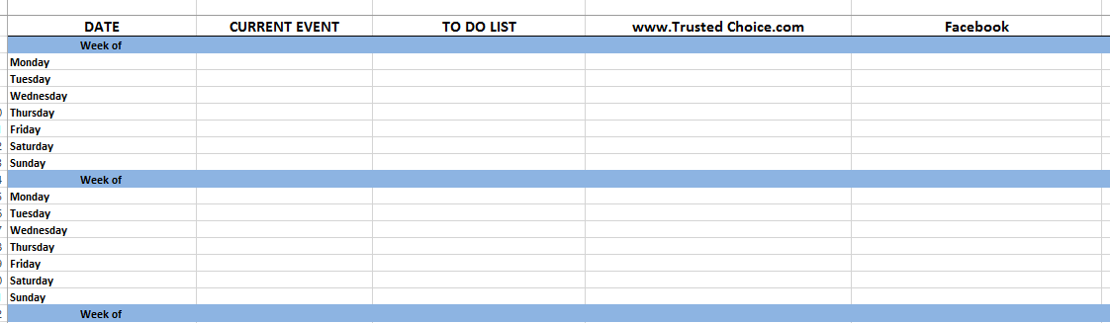
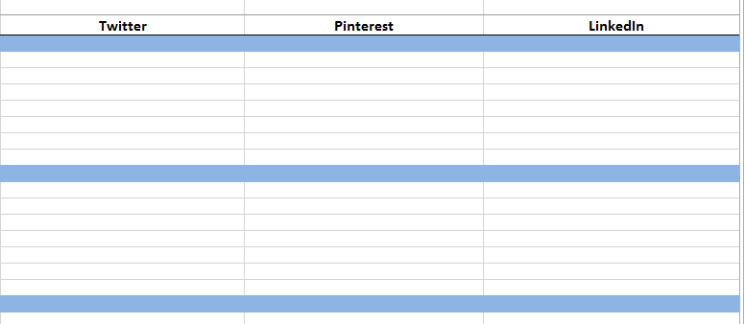
6 - Prospect Effectively
Organize Yourself. Make A Plan. Work it!
37
Notes:
Page 37 in CSE
Now that you have all this, organize yourself. Trusted Choice offers a sample editorial calendar.
The image is above is a screen shot from the Excel document.
Organize by date
Current Event
To Do List
Web Page
Agency
Twitter
Facebook
Pinterest
Linked In
Change to make it work for your agency! This Excel document is available online for downloading.

Slide 39

6 - Prospect Effectively
Notes:
RELATED RESOURCE:
IIABA’s Agents Council for Technology (ACT) offers a multitude of resources:
Websites and Social Media
Sales and Marketing
Disaster Planning
Security and Privacy
Strategic Future Trends
Changing Nature of Risk
Web: www.independentagent.com/act
For more information – contact Ron Berg (Ron.Berg@iiaba.net) or Whitnee Dillard (Whitnee.Dillard@iiaba.net)
ACTIVE LINK: The picture above is hyperlinked to ACT page.

Slide 40
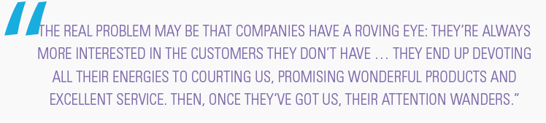
7 - Care for New Customers
39
Notes:
Page 39 in CSE
Are you serving your both your existing and new customers?

Slide 41
7 - Care for New Customers
5 Simple Things That Can Make A Difference!
Show customers you care long after the first sale is a wrap:
1. Share Your Insurance Knowledge
2. Inquire, Listen, Communicate, Adapt
3. Thank your customers!
4. Host “Customer Care” Events
5. Be active in the community and give back
41
42
Notes:
Page 41-42 in CSE
Breaking down the inquire, listen, communicate and adapt
· Inquire Find out what your customers have on their mind, including things like satisfaction with their most recent sales or service experience with your employees. Solicit feedback using various method like e-mail communications, online surveys, comments directly on your website, after online inquires, and via notes sent in the mail Knowing what they want, like and value will help you keep their business.
· Listen to what customers and others have to say about your agency in survey responses, on social media, feedback forums and in general conversation. Good or bad, consider providing survey results, social media responses and answers to customer questions in your e-mail newsletter and other communications.
· Communicate with customers quickly when they contact your business, whether it's a complaint or a compliment. Let them know that you hear them and that you care. Quickly fix problems and never let a customer walk away feeling like they were not heard or that you minimized their issue.
· Adapt your agency operations based on customer feedback to better meet your client’s needs. Let them know that you heard them, valued their feedback and are creating the customer experience based on what they say they want.

Slide 42

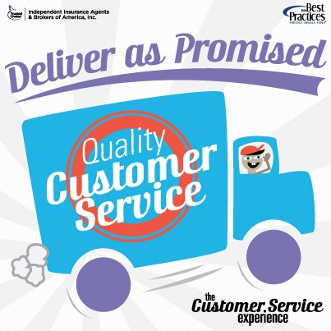
7 - Care for New Customers
Notes:
OPTIONAL WORKSHEET – “Care for New Customers” Checklist (Page 74 in CSE)
If a three-hour class, this can be referenced as something to use back in the office.
If a six-hour class, attendees can take time to go through the questions and ask to share results and feedback.

Slide 43
8 - Retain Customers and Grow Your Book
Retaining your clients is one of the most important aspects of your agency’s operation.
It takes hard work to bring new clients to your agency, whether that be through online or offline efforts, so it is critical that you work to keep them more than satisfied once they become your insureds.
44
Notes:
Page 44 in CSE
You have your clients, make sure you keep them! Customer retention is critical.
66% of financial executives said acquiring new customers was the top strategic objective for their loyalty program. (Source: Forrester)
Consumers will admit that it is frustrating dealing with a company that does not make it easy to do business with them. Don’t be that.
25% of employers have seen an increase in customer loyalty after increasing employee educational requirements (Source: CareerBuilder)
What do other industry’s do for loyalty retention efforts? – It comes down to value added services.
Loyalty programs (restaurants, airlines)
Coupons
Advanced notice on products
Free shipping
Make a game out of things (contests)

Slide 44
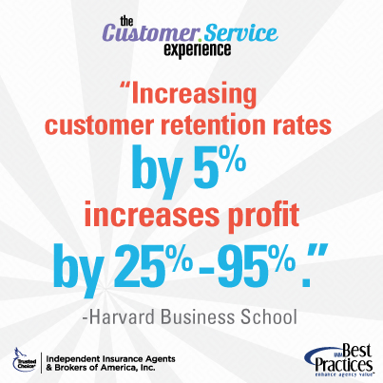
8 - Retain Customers and Grow Your Book
Tip: Thank of client retention as a sales strategy!
1. Consider setting up a “Retention” Department
2. Institute a mandatory annual review of every insured
3. During those annual reviews, create a plan to cross-sell other insurance products
4. If you know that a price increase is coming, get in front of it with your insureds
5. Make insureds feel like family!
6. Know that your clients might need your help to have a positive claims experience.
44
Notes:
Page 44 in CSE
KEY POINTS
A “retention department” -- This group would be in charge of insuring that all agency outreach is consistent and that every employee is held accountable for delivering an exceptional experience during every client contact. They should be creative and set up policies and procedures that ensure everyone is responsible for client retention. Reward success with small financial incentives if retention rates remain high!
Regarding the price increase… Give them a call and provide them with all the information that you have about the increase and how it may impact their premiums going forward. Provide them options that might help offset the increase and be able to explain the impact they their own actions may have had on the increase. They will respect your honesty and continue to value your advice in the future. Remember, an unexpected and unexplained premium is one of the biggest incentives for an insured to shop around for new coverage!

Slide 45
8 - Retain Customers and Grow Your Book
1. Compare the retention rate of customers who came to your agency via social media channels versus those who didn’t, whether it is through your customer service efforts and separately for any leads that have been generated.
2. Do the customers interacting with your agency on social media tend to also call your agency for help?
3. Social media may allow you to turn complaints into opportunities.
4. Are your social media followers more or less likely to buy more coverage?
45
Notes:
Page 45 in CSE
PENDING ITEM: Do we have any retention facts or social media success stories to share here?
OPTIONAL WORKSHEET – Retain Customers and Grow Your Book of Business “Things To Think About” (Page 75 in CSE)
If a three-hour class, this can be referenced as something to use back in the office.
If a six-hour class, attendees can take time to go through the questions and ask to share results and feedback.

Slide 46
8 - Retain Customers and Grow Your Book
Social Media is integral to purchase decisions.
Types of online sources visited for company, brand or product info:
70% social media sites
68% company websites
57% online news
49% review sites
44% Wikipedia
46
Notes:
Page 46-47 in CSE
83% of B2B or Professional Services buyers’ research online before making a purchase decision. (Source: Source: trovus.co.uk)
More than half of Facebook fans say social media influences their buying decisions and 67% of Twitter followers report the same. (Source: iModerate)
Of adults under 35 more than half (52%) visit more than two websites before visiting a local business. (Source: Source: marketingmatters.dexone.com, Daniel Kehrer (2/3/12)
63% head to Google
24% visit Facebook
21% look to site reviews
Your competitors are already online!! Across all US agency sizes:
Facebook pages have an average of just over 200 Likes
The average Twitter account has 440 followers
Respondents in the $2.5MM-$5MM and $5MM-$10MM revenue ranges are the most active in social media (Source: BH Burke & Co., Inc., 2012)

Slide 47
8 - Retain Customers and Grow Your Book
Own a topic. Be the expert.
Avoid heavy sales messaging. Tell a story.
Don’t be a know-it-all. Own a few true specialties.
Encourage conversation.
Reply promptly to customer comments.
Make comments on other appropriate sites as well to expand your online impressions.
Be genuine and…social.
47
Notes:
Page 47 in CSE
CLASS TIP: If you aren’t the expert on a topic, coverage, and want to find quality research, be sure to visit the Big “I” Virtual University and your state association education department for classes. (VU: www.independentagent.com/vu)
RELATED RESOURCE: What's the VU? The VU offers access to insurance, business and technology articles, the 'ask an expert' service, many full sample ISO forms, white papers, monthly webcast and ​information on issues affecting today's insurance marketplace. This is a Big “I” Member Benefit.
Web: www.independentagent.com/vu
For more information – virtualuniversity@iiaba.net

Slide 48
8 - Retain Customers and Grow Your Book
Again, survey.. If you don’t know, you can’t address it!
Utilize survey tools to elicit regular feedback from both potential and current customers.
Don’t be afraid to ask “How are we doing?” Asking won’t change the reality. But not asking might mask a potential problem and lead to the loss of an account.
Ask specific, pointed questions and make the survey itself as short as possible.
No more than four surveys a year.
Screen your invite list to ensure you are asking only relevant respondents for feedback.
47
Notes:
Page 47 in CSE
Survey tools are available to aid your process:
Survey Monkey and Zoomerang have merged: simple polls, in-depth research. Simple to complex. Customizable. Works on mobile, web, social.

Slide 49
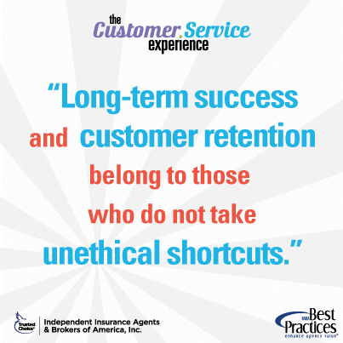
8 - Retain Customers and Grow Your Book
47
Notes:
Pages 47
OPTIONAL WORKSHEET – “Lifetime Customer Value Worksheet” (Page 49 in CSE)
If a three-hour class, this can be referenced as something to use back in the office.
If a six-hour class, attendees can take time to go through the questions and ask to share results and feedback.
ITEM PENDING: LCVW AND HOW TO USE

Slide 50
9 - Be Professional and Trustworthy
How do you measure your reputation with your clients?
Always have your clients’ best interest in mind
Keep your promises.
Be consistent
Keep the conversations real
Be transparent
52
Notes:
Page 52 in CSE
Professionals never guess—they make it their business to know their business.” (Quote: Michelle Moore, Selling Simplified)
Always have your clients’ best interest in mind. Be willing to forego personal gain to give your policyholders the best coverage at the best price. If you can’t help with them a particular need, don’t be afraid to refer them to someone who can.
Keep your promises. If you tell a client you can meet their coverage expectations or budget, back those promises up. They won’t forget if the price is higher or if you assured them a claim was covered, when in reality it isn’t.
Be consistent. An insured’s ability to trust you depends on consistent and persistent behavior. When a customer knows how you will behave, they are more likely to trust you.
Keep the conversations real. Every meeting should be a conversation, not a sales pitch. You should spend half your time with each customer listening, and be sure that the conversation is relevant and has substance.
Be transparent. Understand what it means to be transparent. Your clients are smart—they know when you are being truthful and upfront and when you’re lying. Don’t hide your mistakes and always address any issues or misunderstanding directly. Never avoid the topic and let them know what steps you’re taking to handle the issue and prevent it from happening in the future.

Slide 51
9 - Be Professional and Trustworthy
Tactics To Build Trust
1. Know who is boss.
2. Be a good listener
3. Identify and anticipate needs.
4. Make customers feel important and appreciated.
5. Help customers understand your systems.
6. Appreciate the power of "Yes“
7. When something goes wrong, apologize.
8. Give more than expected.
9. Get regular feedback.
10. Treat employees well.
53
54
Notes:
Page 53-54 in CSE
Know who is boss. Henry Ford put it well: “Employers only handle the money—it is the customer who pays the wages.”
Be a good listener. Take the time to identify customer needs by asking questions and concentrating on what the customer is really saying.
Identify and anticipate needs. Customers don’t buy products or services. They buy good feelings and solutions to problems.
Make customers feel important and appreciated. Treat them as individuals. Always use their name and find ways to compliment them, but be sincere.
Help customers understand your systems. Your organization may have the world’s best systems for getting things done, but if customers don’t understand them, they can get confused, impatient and angry.
Appreciate the power of “Yes”. Always look for ways to help your customers. When they have a request (as long as it is reasonable), tell them that you can do it.
When something goes wrong, apologize. It’s easy and customers like it.
Give more than expected. Since the future of all companies lies in keeping customers happy, think of ways to elevate yourself above the competition.
Get regular feedback. Encourage and welcome suggestions about how you could improve.
Treat employees well. They are your internal customers and need a regular dose of appreciation.

Slide 52
9 - Be Professional and Trustworthy
Other Tactics
Employ an upbeat tone—essential in phone communication.
A sense of humor can make a potentially stressful interaction more enjoyable.
Producers and CSRs should be familiar with client accounts and conversant on specific needs.
Agency-initiated communication with clients is a must.
Notify clients well before deadlines about options and changes in coverage.
55
Notes:
Page 55 in CSE

Slide 53
9 - Be Professional and Trustworthy
Other Tactics
Respond to changes in customers’ life cycles.
Encourage proper protection
Have a customer satisfaction coordinator—a “concierge” of sorts—to oversee special activities over and above insurance services
Conduct a full account review of each personal lines account at least every two years using a written exposure checklist
55
Notes:
Page 55 in CSE
Responding to customer lifecycle changes:
​Contact the insured before a child reaches driving age. Offer to explain to the child how he/she can help keep the family’s rates to a minimum
Contact a policyholder nearing retirement age regarding an annuity.
Recommend increasing policy limits/add a personal umbrella policy as clients gain assets.
Conversely, set up reminders to yourself to recommend that clients decrease coverage of their automobiles as they lose value. You will gain great loyalty from doing this.
Encourage proper protection. Provide advance advice to policyholders in disaster-prone areas and to special-issue clients; e.g., pools, dogs, etc.
Consumer advice is available at www.independentagent.com and www.trustedchoice.com​.
OPTIONAL WORKSHEET – Things To Think About (Page 79 in CSE)
If a three-hour class, this can be referenced as something to use back in the office.
If a six-hour class, attendees can take time to go through the questions and ask to share results and feedback.

Slide 54
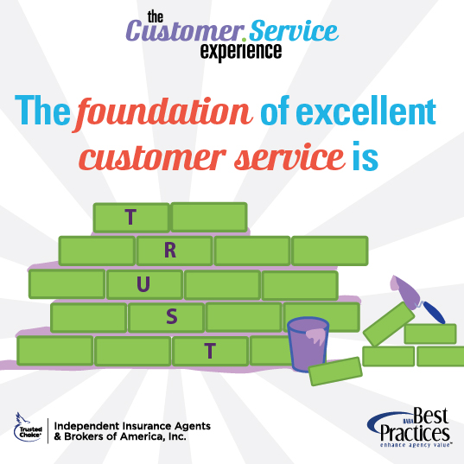
9 - Be Professional and Trustworthy
53
54
55
Notes:
Page 53, 54, 55 in CSE (Graphics, Only)
OPTIONAL WORKSHEET – “Be Professional and Trustworthy” – Professional Agency Tactics (Page 77 in CSE)
If a three-hour class, this can be referenced as something to use back in the office.
If a six-hour class, attendees can take time to go through the questions and ask to share results and feedback.
RELATED RESOURCE: The Big “I” Virtual University offers a featured resource area where insurance issues are explained from a consumer perspective. Article titles/sampling:
Homeowners Articles
The Homeowners Policy & College Students
The Homeowners Policy & Consequential Damage
Insuring Property in Storage
What You Don't Know About Renters Insurance
Personal Auto Articles
Top 10 Reasons to Buy the Rental Car Damage Waiver
The Personal Auto Policy & College Students
The Personal Auto Policy & Company Cars
The Personal Auto Policy & Diminished Value Claims
The Personal Auto Policy & Pizza Delivery
Commercial Insurance Articles
Sprinkler Systems...Two Thumbs Up! (PDF)
Business Interruption Insurance
Insuring the Loss of Your Customers' Data

Slide 55

10 - Be Ready For Unplanned Communication
​​Is your agency prepared to deal with a call from an upset client, with a major fire at an insured business, or simply an online negative review about your sales or service? While all different, all are likely unexpected and requires internal planning and discussion to ensure that your response is timely and effective.
57
Notes:
Page 57 in CSE
CLASS INVOLVEMENT/OPTIONAL EXERCISE: Depending on how time is going. This is an area ripe for story sharing. From customers to disasters.. Attendees can share lessons learned and their agency story or best practices for real-life examples of Do or Don’ts!

Slide 56
10 - Be Ready For Unplanned Communication
LISTEN…hear what they have to say and don’t interrupt until they are finished.
REPEAT…Once they have finished, repeat back what you heard and ask questions to better understand their perspective.
APOLOGIZE…Remember that an apology will often diffuse the situation.
ASK…Work with the customer to find an acceptable solution and you can start by asking them "What would be an acceptable solution to you?"
SOLVE…If you need to work with someone else internally to solve it, do so quickly!
57
Notes:
Page 57 in CSE

Slide 57
10 - Be Ready For Unplanned Communication
There is no getting around customer complaints. But, if you and your service teams use these tips to navigate through the client’s issues you can turn challenges into growth opportunities.
57
Notes:
Page 57 in CSE
There is no getting around customer complaints. It happens! But you can negotiate and handle it.
-------------
RELATED RESOURCE: Tips for Customer Friendly Writing Techniques (Source: www.CustomerServiceGroup.com)
Tips:
- Develop a polite opening. If dealing with a complaint, apologize!
- Choose words and phrases that are positive. Just as if you were on the phone, choose your words wisely.
- Offer specific, concise details of the resolution.
- Close by thanking the customer for their business.
- Leave the contact channel open.
- Proofread!

Slide 58

10 - Be Ready For Unplanned Communication
SOCIAL MEDIA SCARES
Negative news
Professional Response to a Negative Review
58
Notes:
Page 58 in CSE
Negative news
Even if your agency isn’t using social media, someone is online talking about you. Wouldn’t you like to be part of that dialogue? Wait and it could be too late.
If you aren’t already engaged online and talking about your brand, just one negative news story can be rocket to the top of the search engine results.
​Every mention and every connection you create in cyberspace creates a rich network of brand content.
If you haven’t established your own content and claimed an online foothold for your brand on your own terms, it can become extremely difficult to make up lost ground later.
Professional Response
Keep your composure and never engage in a virtual shouting match with someone online, even if the post was off base or even false. If the post is threatening or in some way may violate the Terms of Service for the site, flag it for the site’s support team to review and possibly have it deleted.
Be civil and professional in your response to any online review. Give your professional perspective of the situation and offer a solution. It is important to show others that you have taken the time to address the poster’s concern and have taken steps to solve the problem. If the poster is someone that you know professionally or personally, consider a private message or outreach through another method to discuss.
Don’t respond to one compliment or compliant, but not others. Consistency is critical to establishing your online reputation! Consider having the marketing department be in charge of monitoring and responding to online posts about your agency.

Slide 59

10 - Be Ready For Unplanned Communication
Disaster Communication
Social media can also prove an important tool for reaching customers during disasters.
​
Even when phone lines or power are interrupted, smart phones often still work.
59
Notes:
Page 59 in CSE
KEY POINT: If your agency has generated a strong following online or have a contact list of customer cellphone numbers, you can maintain important communication during particularly difficult times. This is when your value as an agency can be solidified for life.
Things to consider with a disaster plan: (Source: Best Practices of Crisis Management. This is out of print.)
• Outline initial steps to determine if the plan needs to be executed.
• Provide guidelines to help individuals prepare for a possible business interruption.
• Assign and describe duties to each member of the resumption team.
• Communicate clearly to employees about the actions to be taken.
• Provide an external communications guide.
• Provide a fast reference for all critical services.
• Provide a framework for ongoing improvement and updating of the plan.

Slide 60
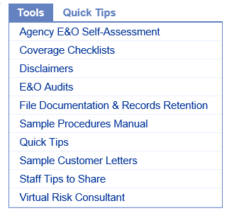
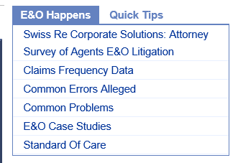
10 - Be Ready For Unplanned Communication
IMPORTANT TIP
Many agencies already actively use social media, while others are still exploring it. For some, there are questions of whether social media sites will supplant the need for traditional websites. While social media is an excellent way to connect with customers, increase visibility of the agency, and build relationships with prospects, its usage does have some E&O exposure.
Check out the E&O Happens​ site for information about social media use and your exposure.
59
Notes:
Page 59 in CSE
The graphics are linked to the following web page: http://rms.iiaba.net/Content/default.aspx

Slide 61
10 - Be Ready For Unplanned Communication
TEXTING
Do you text with your agency clients? If so, it’s important to establish firm guidelines for texts and to understand the possible business implications as well as E/O issues that can come from accepting texts:
Critical Information Could Be Lost.
Texting is Distracting.
Unrealistic Expectations
60
Notes:
Page 60 in CSE
OPTIONAL WORKSHEET – “Be Ready For Unplanned Communication” (Page 78 in CSE)
If a three-hour class, this can be referenced as something to use back in the office.
If a six-hour class, attendees can take time to go through the questions and ask to share results and feedback.

Slide 62

11 - Plan For The Future
62
Notes:
Page 62 in CSE

Slide 63
11 - Plan For The Future
The world of insurance is changing at an extraordinary pace.
Technology tools and myriad access points for the latest information have caused a profound shift has occurred for agencies.
Your insureds and future customers have more power than ever before to research and read reviews.
Your employees are using new tools to service clients, improve workflows and simply sell insurance.
Social media has created the expectation that the workplace will be transparent.
62
Notes:
Page 62 in CSE
The world of insurance is changing at an extraordinary pace. With the widespread reach of all things Internet, the vast array of technology tools and myriad access points for the latest information, a profound shift has occurred for agencies.
Your insureds and future customers have more power than ever before, as they come to you having done research about the coverages they need, and having read reviews about your agency.
Your employees are using new tools to service clients, improve workflows and simply sell insurance. They are also working more collaboratively and using the latest technologies to communicate with your clients and with each other. Social media has created the expectation that the workplace will be transparent, and that the use external resources will not only be allowed, but also required.

Slide 64
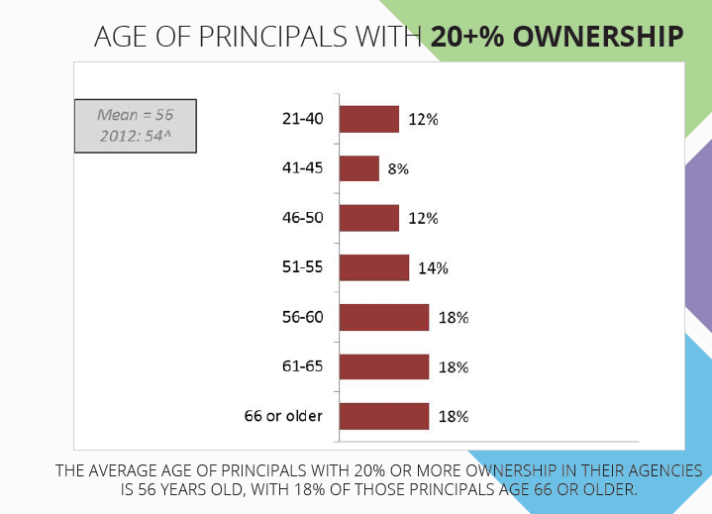
11 - Plan For The Future
THE WAR FOR TALENT
Did you know that the number of professionals age 55 and older is 30% higher in the insurance industry than the rest of the economy and that by 2020 our industry will have an estimated 400,000 job openings?
62
63
Notes:
Page 62-63 in CSE
Agencies must start NOW to find and hire the most promising and smartest workers to keep your agency competitive and relevant and able to provide the service your clients using efficient and techno-savvy means!
IIABA “Best Practices Agencies” Never Stop Hiring! It’s an ongoing effort and part of their strategic plan. (Source: IIABA Best Practices Study – Annual Reports)
About Best Practices: The annual Best Practices Study originated in 1993 as an initiative to help independent agents build the value of their most important asset, their agencies. By studying the leading agencies and brokers in the country, the Big "I" hoped to provide member agents with meaningful performance benchmarks and business strategies that could be adopted or adapted for use in improving agency performance, thus enhancing agency value.
Web: www.independentagent.com/bestpractices
Email: bestpractices@iiaba.net

Slide 65
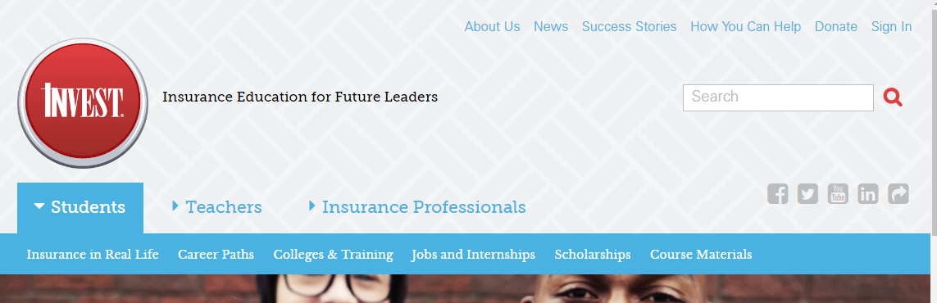
11 - Plan For The Future
Notes:
Page 62-63 in CSE
THE WAR ON TALENT! The Big “I” is working to help the future agency force.
------
ABOUT InVEST
InVEST educates high school and college students about insurance and the wide variety of careers in the industry. For more than 45 years, InVEST volunteers have been in the classroom dispelling the age old myth that the insurance industry is old, boring and doesn’t lead to a rewarding career. Through a hands-on education approach with a variety of lessons students get an idea of what the insurance industry really is—a rewarding and lucrative profession that allows individuals to make a difference.
In the classroom, students learn about risk management, auto, homeowner, life and health insurance in an interactive environment. They get to run their own business, sell and service insurance policies in a mock setting.
Opportunities are available throughout the nation for you to volunteer in the classroom. You are able to share your experience, explain the importance of insurance protection and give insight to an insurance workday. Through InVEST, the insurance industry is poised to attract the best and brightest talent. We have what the next generation wants in a career—security, flexibility, growth opportunities and an opportunity to give back to their community. You have an opportunity to cultivate passionate professionals for your agency or company and provide that spark to encourage more young professionals to love a career in insurance!
There are:
Resources for Students.
Resources for Teachers.
Resources for Insurance Professionals.
Web: http://www.investprogram.org/
For more information – to volunteer – to get your agency involved -- contact Debbie Pickford (Debbie.Pickford@iiaba.net) at IIABA..
ACTIVE LINK: Photo hyperlinks to http://www.investprogram.org/

Slide 66
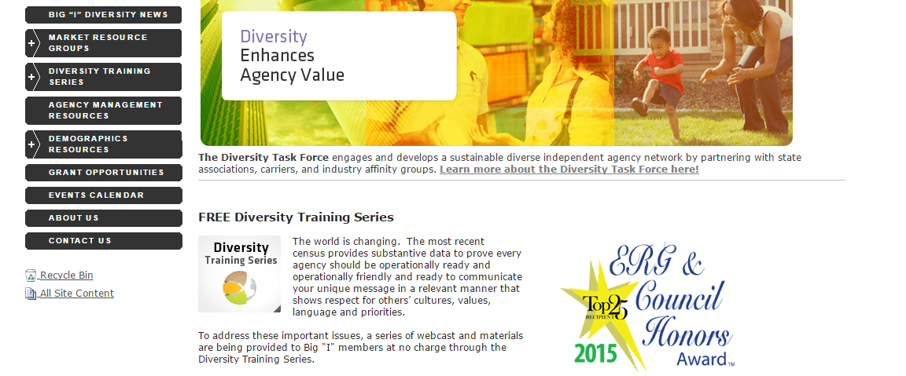
11 - Plan For The Future
63
Notes:
Page 63 in CSE
YOUR CUSTOMERS ARE GOING TO BE DIFFERENT: The Big “I” is working to engage the changing consumer dynamic.
--------
ABOUT THE DIVERSITY TASK FORCE
The world is changing. The most recent census provides substantive data to prove every agency should be operationally ready and operationally friendly and ready to communicate your unique message in a relevant manner that shows respect for others’ cultures, values, language and priorities. The Diversity Task Force engages and develops a sustainable diverse independent agency network by partnering with state associations, carriers, and industry affinity groups
To address these important issues, a series of webcast and materials are being provided to Big "I" members at no charge through the Diversity Training Series, providing resources on different market resource groups, demographics and more..
Web: www.independentagent.com/diversity
For more information – contact Whitnee Dillard or Madelyn Flannagan at IIABA.. Whitnee.Dillard@iiaba.net or Madelyn.Flannagan@iiaba.net
ACTIVE LINK: Photo hyperlinked to http://www.independentagent.com/Resources/StaffDevelopment/Diversity/Pages/home.aspx

Slide 67
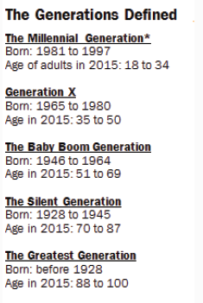
11 - Plan For The Future
YOUR CUSTOMERS WILL BE DIFFERENT
A key to your agency’s future success is understanding that your customer base will change and evolve as the U.S. demographics change. Your customer service team needs to be able recognize and work effectively with customer diversity,
63
Notes:
Page 63 in CSE

Slide 68
11 - Plan For The Future
What are the Industry Disrupters?
Industry Disrupters –
Do they know the underwriting criteria of each of your markets and how these issues are handled company by company? The insurance industry is addressing some of these issues head-on and adding new product lines, endorsements, exclusions and sending out reams of information. Education is critical to protecting your clients and your errors and omissions exposure.
64
Notes:
Page 64 in CSE
Here are some industry disrupters to name and discuss with the class.
Telematics
Telematics is the blending of technology into vehicles and on-board integration within road vehicles
The Internet of things
Driverless cars
Drones
One of the most fluid issues in insurance today involves drones. The technology, regulations, exposures, and coverages seem to change on a daily basis. The VU offers a recorded webinar on this topic for anyone wanting to learn more.
Cybercrimes
Ride sharing
The VU offers a multitude of articles. Here is one: Insurance Implications of Car Sharing: http://www.independentagent.com/Education/VU/Insurance/Personal-Lines/Auto/Rental-Cars/EdwardsCarSharing.aspx
Home sharing
On-demand everything!
Is your service staff up-to-speed on these things and can they help current and new customers effectively navigate the marketplace for the proper coverage? What about things like rides haring or home sharing? Do they know the underwriting criteria of each of your markets and how these issues are handled company by company? The insurance industry is addressing some of these issues head-on and adding new product lines, endorsements, exclusions and sending out reams of information. Education is critical to protecting your clients and your errors and omissions exposure.

Slide 69
11 - Plan For The Future
Staying Social
Agencies must be vigilant to catch the next wave before it passes by, taking customers with it. Consider just these latest online trends:
While Facebook continues to lead the social media pack with 1.15 billion active monthly users, Google+ is quickly gaining steam, and now has the second highest number of monthly users—343 million.
Visual content is vitally important. Is there application for your agency on Pinterest, Slideshare, Tumblr, Path and Mobli? If you don’t know what these sites entail, get online and investigate what your customers and competitors are doing there.
Be sure to include video content when appropriate. From longer format options via YouTube to six second mini-videos via Vine, remember that a picture can say a thousand words. Yes, you’re in insurance, but you can have fun; be creative.
65
Notes:
Page 65 in CSE
FACT: Between the time this information was written and you are reading it, it’s likely something new has come to the forefront. Stay engaged.
While Facebook continues to lead the social media pack with 1.15 billion active monthly users, Google+ is quickly gaining steam, and now has the second highest number of monthly users—343 million (Source: www.cosida.com)

Slide 70
11 – Plan For The Future
Monitor and Measure
Many firms are frustrated by social media, in particular, because it can be difficult to capture a monetary ROI. But there are other important measurements you can use to gauge effectiveness (be sure to start with a baseline measure.)
Website traffic
Number of new business partnerships
Exposure
Search ranking
Number of qualified leads captured
Number of likes, follows, comments etc.
Number of successful closed business leads
Reduction in marketing expenses
66
Notes:
Page 66 in CSE
OPTIONAL WORKSHEET – “Plan for The Future” Checklist (Page 79 in CSE)
If a three-hour class, this can be referenced as something to use back in the office.
If a six-hour class, attendees can take time to go through the questions and ask to share results and feedback.

Slide 71
Conclusion
Your independent agency today has more opportunities to prosper than ever before in the history of the insurance industry.
Today’s marketplace allows your agency to be the hub of its own community as well as a member of many other communities – all populated by consumers.
Some of these consumers are your customers, and you want to make sure they stay with you. Others are prospective customers who need to be convinced to do business with you.
Utilize social media, your stories, connections, and the power to connect.
The manual and course have offered direction that will help you to confidently and efficiently provide meaningful, valuable and profitable customer service as a foundational component of your business.
Notes:
In conclusion:
Your independent agency today has more opportunities to prosper than ever before in the history of the insurance industry.
The complexion of today’s marketplace allows your agency to be the hub of its own community as well as a member of many other communities – all populated by consumers.
Some of these consumers are your customers, and you want to make sure they stay with you. Others are prospective customers who need to be convinced to do business with you.
Utilize social media, your stories, connections, and the power to connect.
The manual and course have offered direction that will help you to confidently and efficiently provide meaningful, valuable and profitable customer service as a foundational component of your business.
-------
Worksheets are available online electronically: www.independentagent.com/csexperience
If looking for supplemental resources, the Agents Council for Technology web has a wealth of resources to tie in from their website, social media, sales and marketing area.

